Slide 1
Pain: shedding Light on inequities of health
Spontaneous Intracranial Hypotension
A Survival Guide for Patients and Primary Health Care Providers
Dr. Rosann Seviour MD MSc FRCPC

Slide 2
Pain: Shedding Light on Inequities of Health : Ehlers Danlos Syndromes and related disorders, as well as Spontaneous Intracranial Hypotension Caused by a Spinal CSF Leak - Saturday November 7, 2020
Rosann Seviour MD MSc FRCPC
Medical Officer of Health
Department of Health and Community Services
NL
Advisory Board for CSF Leak Canada

Slide 3
Spontaneous Intracranial Hypotension: A Survival Guide for Patients and Primary Health Care Providers
Gain awareness of issues of under-diagnosis, misdiagnosis delayed diagnosis
Gain insight into how the complexity of diagnosis and health system issues can add to delays in diagnosis
To increase awareness of actions and resources that can assist both patients and PCPs

Slide 4
Spinal Cerebrospinal fluid (CSF) leaks
Spontaneous, traumatic, post operative, post epidural
can all lead to intracranial hypotension
Spontaneous
Rare verses underdiagnosed/misdiagnosed/delayed diagnosis
No large studies looking at the incidence or prevalence
Estimated incidence of SIH is 5/100,000 per year
History of Heritable Disorders of Connective Tissue
Diagnosis and treatment remain a challenge
Wouter I. Schievink et al. J Headache Pain (2007) 8:325-328

Slide 5
Spontaneous Intracranial hypotension
In the last decade
Broader clinical spectrum recognized
Improved and innovative diagnostic imaging
New entities recognized – CSF-venous fistula
Some increased awareness
Increased publications

Slide 6
Spontaneous Intracranial hypotension
Still issues around misdiagnosis and diagnostic delay
Calgary SIH registry
Lack of services
Access to services
No randomized control trial on treatment

Slide 7
I have looked at life from both sides now
Family physician
Only heard of post-lumbar puncture CSF leak
Aware of the challenges around a complex diagnosis
Knew the importance of a patient being their own advocate
Patient
Live in small province with limited access to specialists
My story is like so many others
Pain a limiting factor in ability to self-advocate

Slide 8
Been there, done that
 | Cancer | CSF leak
Diagnosis | Delayed | Delayed
Imaging/Tests | Multiple/layered | Multiple/layered
Imaging results/ interpretation | Difficulties but progression | No clear progression
Mutlidisciplinary team | FD Oncologist Radiation oncologist General surgeon Plastic surgeon | FD Neurologist (Headache neurologist) Neuro-radiologist Anesthesiologist (Neuro-anesthesiologist) (Neurosurgeon)
Multidisciplinary approach | Established | Fragmented
Limiting factors | Fear | Pain
System Support | Cancer clinic/patient navigator | None
Societal Support | OMG cancer | Looks well with headache

Slide 9
Comparisons and Contrasts
Delayed diagnosis
What’s common is common
Varied symptomatology and normal exam
If your doctor/NP has never heard of it he/she can never diagnose it
Imaging/tests
Need clear practice guidelines/diagnostic pathway
If not this then let’s try this
Treatment
Clear treatment options/CPG
Standard of care

Slide 10
Comparisons and Contrasts
Team approach
Fundamental element in good care
Case conference
Support
Pain/disability
Makes seeking/establishing/maintaining support more difficult

Slide 11
Cancer care Delivery strengths
Team approach
Case conferences on difficult/unusual cases
Diagnostic algorithms – same across the country
Treatment guidelines - same across the country
Standards of care/Best practices
Clinical trials of treatment modalities
Support systems within the health services system
Patient navigator
Support network outside the health services system

Slide 12
Pain: Shedding light on inequities in health
The Pain
No comparison
George Clooney
Started to drink heavily
So what do you do?

Slide 13
Survival guide for patients
Be aware this is going to be a journey
Don’t carry this on your own
Be your own advocate
Build your own team
Tap into other resources
Not easy when your head hurts

Slide 14
Survival guide for patients
Build your team
Sorry you are going to have to educate them
Doesn’t need to be big
Family/friends - those who accept your illness
- don’t focus on those who don’t get it
Your family doctor
Patient navigator/client relations officer
Massage therapist/physiotherapist
Other people with CSF leaks

Slide 15
Getting Angry
Anger is an appropriate response to injustice
Direct it appropriately
not at yourself
not at your family
not at your GP
not at your team
Remember they are all human with their own failings
Really? Compassionate action
Ask your FD/HCP about seeing a counsellor

Slide 16
Resources: Dealing with the Reality gap

Slide 17
Resources: Dealing with the Reality gap
Meditation
Deepak Chopra and Oprah Winfrey free 21 day meditation challenge
Mindfulness
Relief from the daily negotiation of living with a CSF leak
Self Compassion
Kristin Neff
Support Websites
Spinal CSF Leak Canada - https://www.spinalcsfleakcanada.ca/
Spinal CSF Leak Foundation -https://spinalcsfleak.org/
Canadian Facebook Support Group
Spinal CSF Leak Support Group and Discussion Community - www.inspire.com

Slide 18
Your Primary Care Provider – family Doctor or Nurse practitioner
What’s common is common
Can’t make a diagnosis on something they don’t know anything about
He/she is human
Compassionate action
It is OK to bring an article or other information
available on the Spinal CSF Leak Canada site

Slide 19
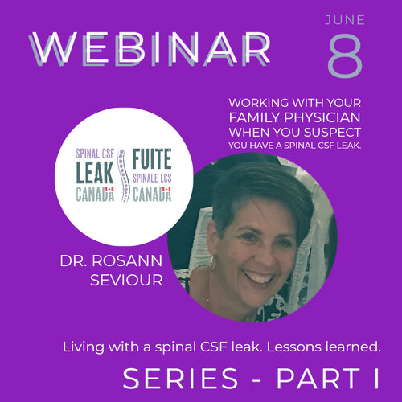
Short video

Slide 20
Primary Care Provider Survival
It is likely going to be a long road
With road blocks
Prepare to be confused at times
Don’t carry this on your own
Other modalities
See regularly in follow-up
Try new avenues

Slide 21
Primary Care Provider Survival
ROAD BLOCKS
Diagnosis
Appropriate diagnostic imaging
Scans – a negative scan doesn’t rule out the diagnosis
Neurologists
Headache specialists
Epidural blood patch
Team approach

Slide 22
Primary Care Provider Survival
DO NO HARM
LEAVE NO STONE UNTURNED

Slide 23
The Malingerer
After LP worsened symptoms
woman crying in ER with a headache
Small rural community
went to bed at 19
tall thin
Davis inlet
carried on board
community knew what he was

Slide 24
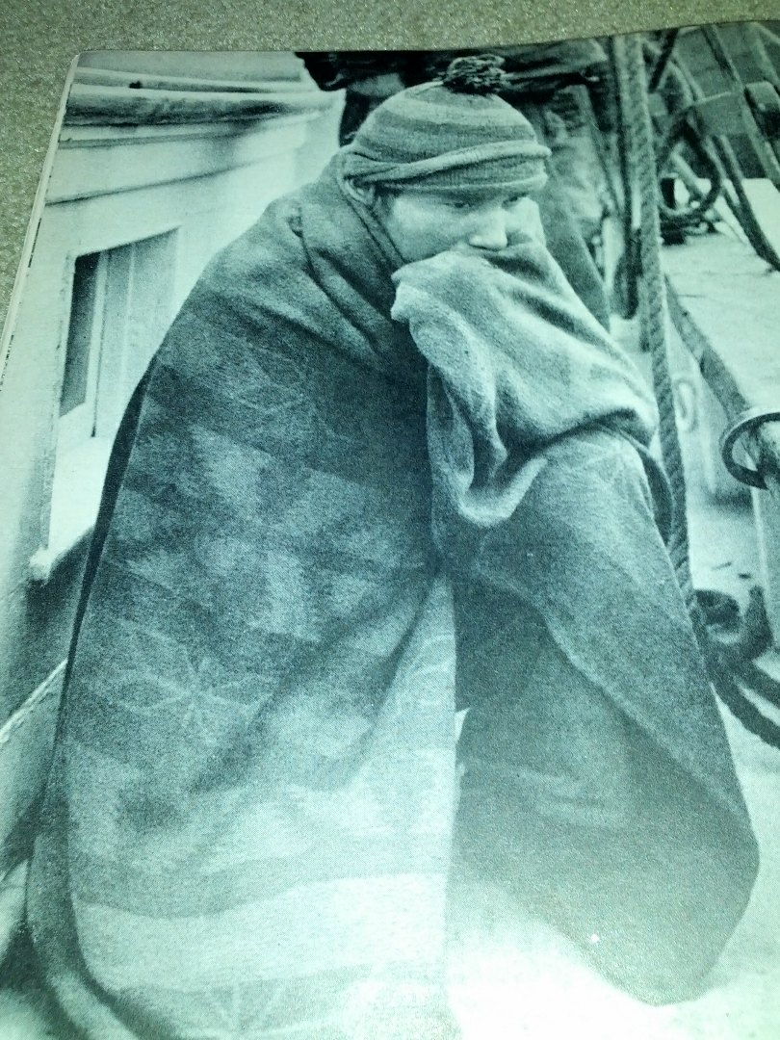

Slide 25
The System approach
Goal of uniformity of diagnosis, treatment and support
Team approach
Evidence-based decisions - research
Clinical Practice Guidelines for diagnosis and treatment
Innovation
Referral centres
Patient navigators and supports

